Slide 1
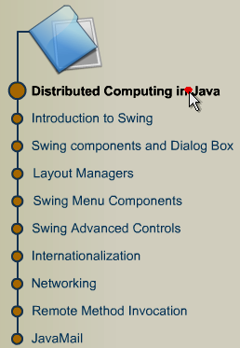
Module Introduction
Distributed
Computing
in Java

Slide 2
Session 1
Module 1: Introduction to SWING
Module 2: Swing Components
and Dialogs

Slide 3
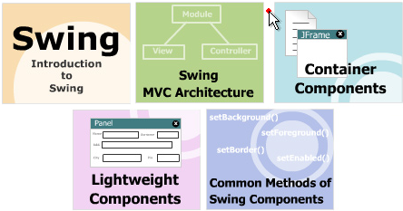
Module 1: Introduction to SWING
Objectives

Slide 4
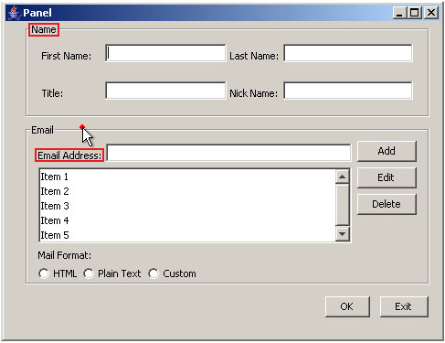
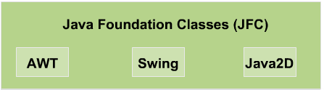
1.1-Introduction
How to create
this interface?

Slide 5
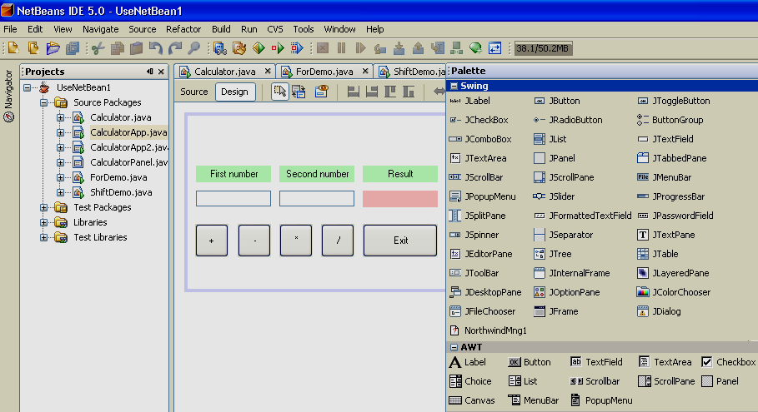
JFC in NetBeans

Slide 6
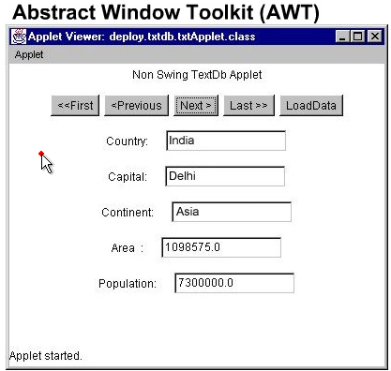
AWT
Support Application, Applet programming

Slide 7
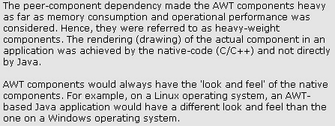
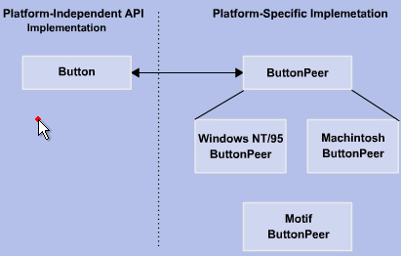
AWT

Slide 8
Benefits of swing
Swing components are lightweight as compared to AWT
components.
Swing allows Pluggable-Look-And Feel control.
Borders drawn around most of the Swing components can
be changed.
Appearance of Swing components can be changed by either
invoking methods on it, or by creating a subclass of it.
Swing components don’t have to be rectangle
(buttons can be round)
Swing is based on the Model-View-Controller Architecture.

Slide 9
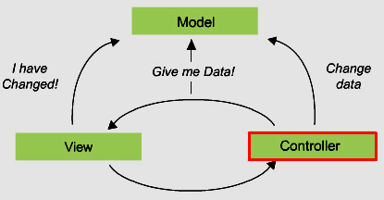
Model-View-Controller Architecture
Code to maintain data.
Code to represent graphics
Code to control user interaction.

Slide 10
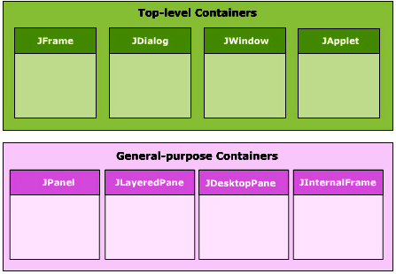
Containers
4 parts of a root pane:
Glass pane
Layered pane
Menu bar
Content pane

Slide 11
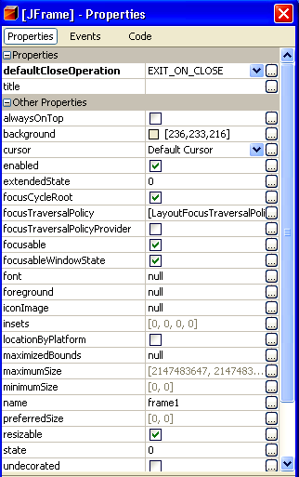
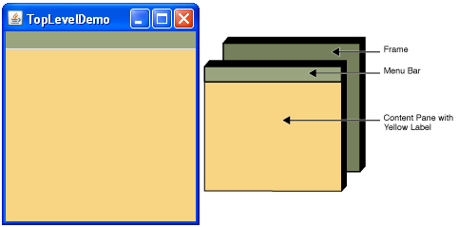
Top-Level container:Class JFrame

Slide 12
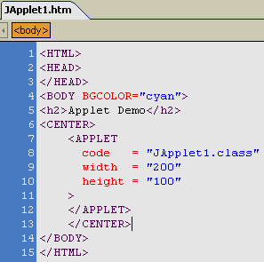
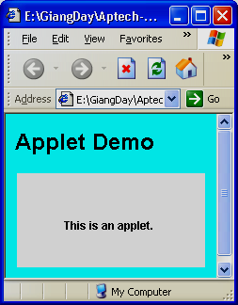
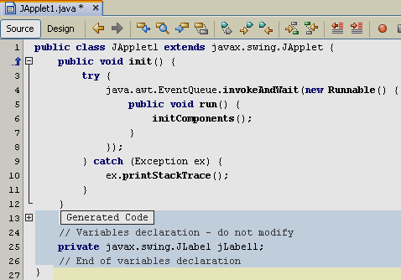
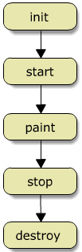
Top-Level container: Class JApplet

Slide 13
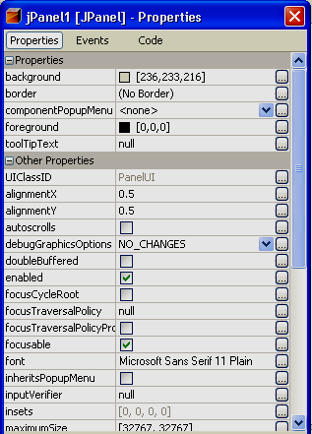
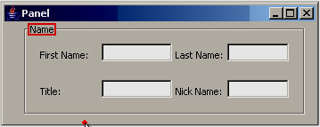
General purpose container: JPanel
Intermediate container.
General-purpose container
for lightweight components
Groups some related lightweight
components.

Slide 14
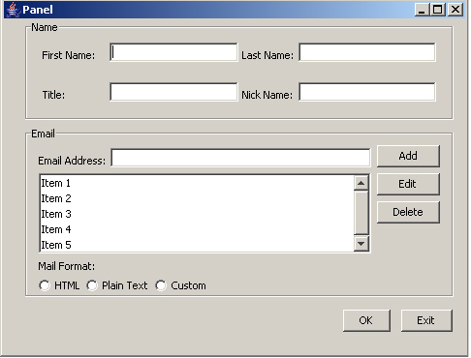


Lightweight Components
JLabel
JTextFiels
JCheckBox
JPasswordField
JTextArea
JRadioButton
JButton

Slide 15
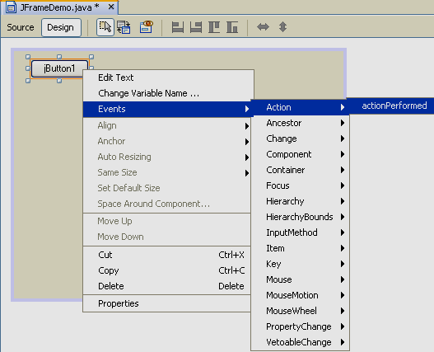
Lightweight Components: Event handling
Event handling in NetBeans

Slide 16
Lightweight Components: Event handling
Object | Event | Interface | Method
JButton | ActionEvent | ActionListener | actionPerformed()
JCheckBox | ActionEvent ItemEvent | ActionListener ItemListener | actionPerformed() itemStateChanged()
JRadioButton | ActionEvent ItemEvent | ActionListener ItemListener | actionPerformed() itemStateChanged()
JTextField JTextArea | ActionEvent FocusEvent | ActionListener FocusListener | actionPerformed() focusGained(), focusLost()
JPasswordField | ActionEvent | ActionListener | actionPerformed()

Slide 17
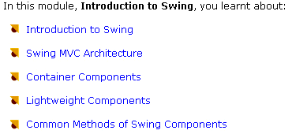
Module 1 Summary

Slide 18
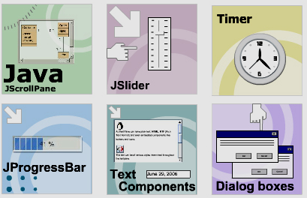
Module 2: Swing Components and Dialogs
Objectives:

Slide 19
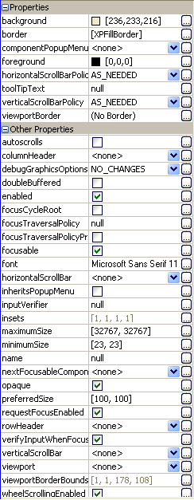
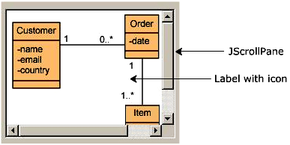
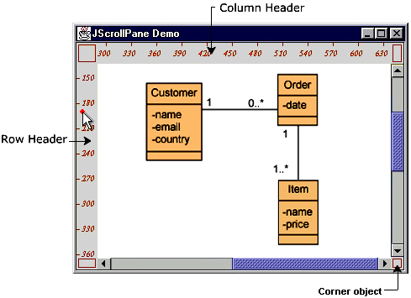
JScrollPane class
Provide a scrollable view of a component
Parts of a scrollpane

Slide 20
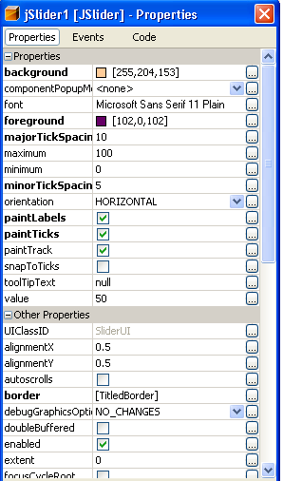
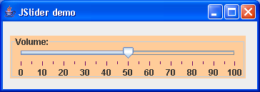
JSlider class
Event handling:
java.swing.event.ChangeEvent
ChangeListener
public void stateChanged(ChangeEvent e)

Slide 21

javax.swing.Timer class
To perform a task once, after a delay.
For example, the tool tip manager uses Swing timers to determine when to show a tool tip and when to hide it.
To perform a task repeatedly.
For example, you might perform animation or update a component that displays progress toward a goal.
Constructors:
Timer ( int miliSecDelay, ActionListener listener)
Common used methods

Slide 22
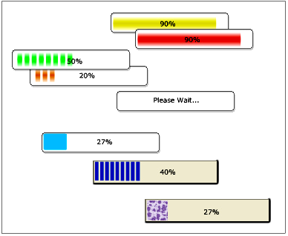


javax.swing.JProgressBar class
A Progress bar is used to display the progess of a time consuming operation.
A Timer is used to determine the amount of task completed and accordingly update the progress bar
Constructors
Event handling
ChangeListener interface
public void stateChanged(…)
Common methods

Slide 23
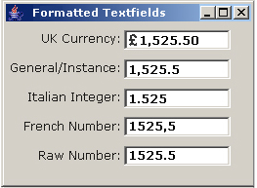
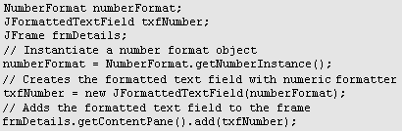
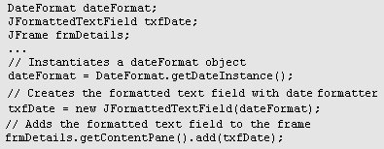
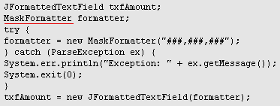
javax.swing.JFormattedTextField class
Create number formatted textfield
java.text.NumberFormat
Create customized format
Create date formatted textfield
java.text.DateFormat
javax.swing.text.MaskFormatter

Slide 24
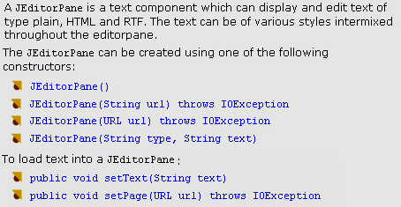
javax.swing.JEditorPane class

Slide 25
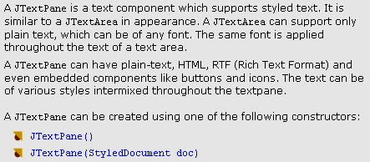
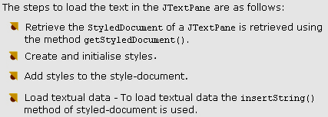
javax.swing.JTextPane class

Slide 26
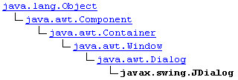
Dialog box
Types of Dialog boxes:
  Modal dialog boxes
  Non-modal dialog boxes
Pre-defined standard dialog boxes:
JOptionPane class.
ProgressMonitor class
JColorChooser class
JFileChooser class
Create custom dialogs,
use the JDialog class directly.

Slide 27
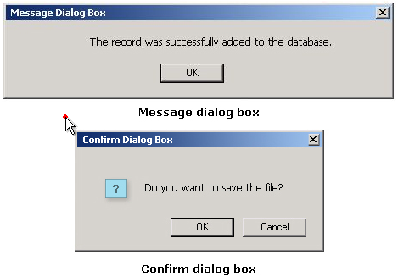
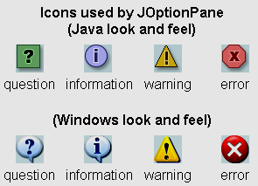
javax.swing.JOptionPane class
title
message
icon
buttons

Slide 28
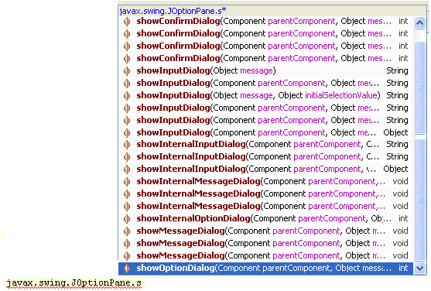
JOptionPane class

Slide 29
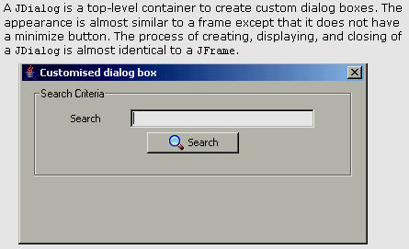

javax.swing.JDialog class

Slide 30
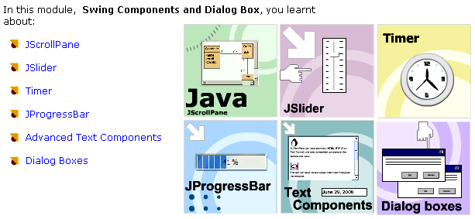
Module 2 Summary

